Slide 1

Review: Probability Theory (3)
Chris Kiekintveld

Slide 2
Possible Worlds
Often in decision making we reason about states of the world
Variables are used to describe features of the state that we care about
Every state has a value for every variable
State space is cross product of variables
Variables may not all be (directly) observed
In dynamic systems, state changes over time

Slide 3
State Variables
Can be Boolean, integer, real, etc.
Evidence (or observed) variables are ones that the agent knows the value of
Hidden variables are ones that the agent does not know the value of
Query variables are not known, but the agent tries to infer the values of these variables from the evidence

Slide 4
Propositional Logic
Logics can be used to describe more complex statements about probabilities
E.g. P(A v B) is the probability of either variable B or A being true
Logical AND (^), OR (v) and NOT (!) are all common to describe complex events

Slide 5
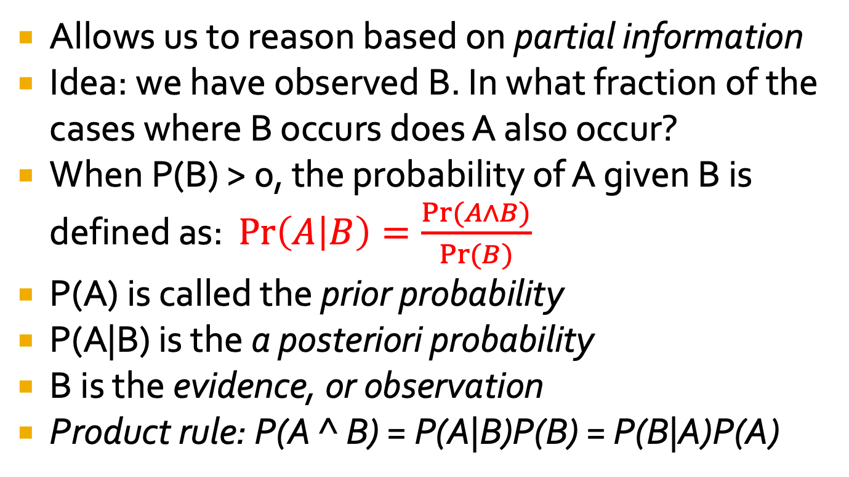
Conditional Probability
Allows us to reason based on partial information
Idea: we have observed B. In what fraction of the cases where B occurs does A also occur?
When P(B) > 0, the probability of A given B is defined as: $\operatorname{Pr}\left(A | B\right)=\frac{Pr⁡(A∧B)}{Pr⁡(B)}$
P(A) is called the prior probability
P(A|B) is the a posteriori probability
B is the evidence, or observation
Product rule: P(A ^ B) = P(A|B)P(B) = P(B|A)P(A)

Slide 6

Conditioning Example
If A and B are events with Pr(B) > 0, the conditional probability of A given B is $\operatorname{Pr}\left(A | B\right)=\frac{Pr⁡(A∧B)}{Pr⁡(B)}$
Example: Drug trial
 | Women | Men
Success | 200 | 1800
Failure | 1800 | 200
A = {Patient is a Women}
B = {Drug fails}
Pr(B|A) = ?
Pr(A|B) = ?

Slide 7
Inference by Enumeration
 | Failed Checksum |  | Passed Checksum
 | AV Alert | No AV Alert | AV Alert | No AV Alert
Malicious | .108 | .012 | .072 | .008
Clean | .016 | .064 | .144 | .576
For any propositional statement, sum the probabilities of the atomic events
where the statement is true:
P(AV Alert) = 0.108 + 0.016 + 0.072 + 0.144 = 0.34
P(Clean ^ AV Alert) = ?
P(Malicious ^ !(Failed Checksum)) = ?
P(!Malicious ^ No AV Alert) = ?

Slide 8
Inference by Enumeration
 | Failed Checksum |  | Passed Checksum
 | AV Alert | No AV Alert | AV Alert | No AV Alert
Malicious | .108 | .012 | .072 | .008
Clean | .016 | .064 | .144 | .576
For any propositional statement, sum the probabilities of the atomic events
where the statement is true:
P(AV Alert) = 0.108 + 0.016 + 0.072 + 0.144 = 0.34
P(Clean ^ AV Alert) = 0.016 + 0.144 = 0.16
P(Malicious ^ !(Failed Checksum)) = 0.072 + 0.008 = 0.08
P(!Malicious ^ No AV Alert) = 0.064 + 0.576 = 0.64

Slide 9
Conditional Probabilities
 | Failed Checksum |  | Passed Checksum
 | AV Alert | No AV Alert | AV Alert | No AV Alert
Malicious | .108 | .012 | .072 | .008
Clean | .016 | .064 | .144 | .576
Can compute conditional probabilities using enumeration as well. Recall:
P(A|B) = P(A^B)/P(B)
P(AV Alert | Failed Checksum) = (0.108 + 0.016) / (0.108 + 0.016 + 0.012 + 0.064)
P(Clean | No AV Alert) = ?
P(Malicious | Failed Checksum ^ AV Alert) = ?

Slide 10
Conditional Probabilities
 | Failed Checksum |  | Passed Checksum
 | AV Alert | No AV Alert | AV Alert | No AV Alert
Malicious | .108 | .012 | .072 | .008
Clean | .016 | .064 | .144 | .576
Can compute conditional probabilities using enumeration as well. Recall:
P(A|B) = P(A^B)/P(B)
P(AV Alert | Failed Checksum) = (0.108 + 0.016) / (0.108 + 0.016 + 0.012 + 0.064)
P(Clean | No AV Alert) = (0.064 + 0.576) / (0.012 + 0.064 + 0.008 + 0.576)
P(Malicious | Failed Checksum ^ AV Alert) = (0.108) / (0.108 + 0.016)

Slide 11
Inference by Enumeration
Let X be the set of all variables.
Want to compute the posterior joint distribution for query variables Y
We observe specific values for the evidence variables E
Hidden variables H = X - Y – E
General algorithm: fix E values, sum over H
Computationally intractable for large domains, but a useful starting point

Slide 12
Probabilities and Combinatorics
# of time event happens
Probabilities are ratios:
Often, determining a probability is just a counting argument
What is the probability of drawing a straight flush in poker?
What is the probability of guessing a 4 digit pin if the digits are selected with replacement? without? What about a 6 digit pin?
# of samples/possible events

